Slide 1

P
BROCKVILLE MINOR HOCKEY ASSOCIATION
U13 LEGION TOURNAMENT
January 16 to 18, 2026
Brockville Memorial Civic Center | 100 Magedoma Blvd
Brockville Centennial Youth Arena | 138 Broadway Ave
Please contact
Ashley Kaert-Brown: ashleykaertbrown@gmail.com
if you have any questions or concerns

Slide 2
Friday January 16 th
ALL Coaches/Managers must register at the Memorial Centre or Youth Arena BEFORE their first game.

Slide 3
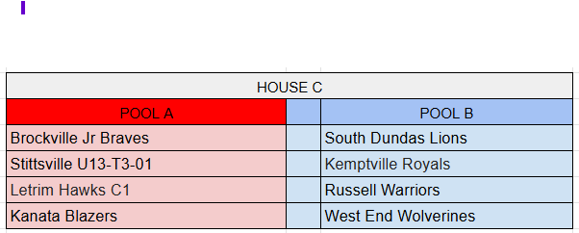
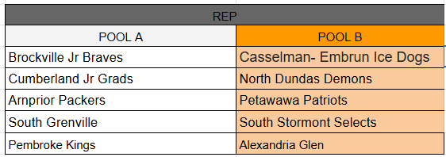
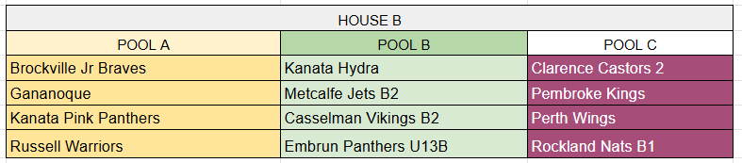
DIVISIONS

Slide 4
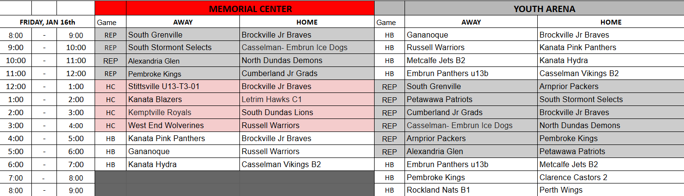
SCHEDULE – FRIDAY JANUARY 16th

Slide 5
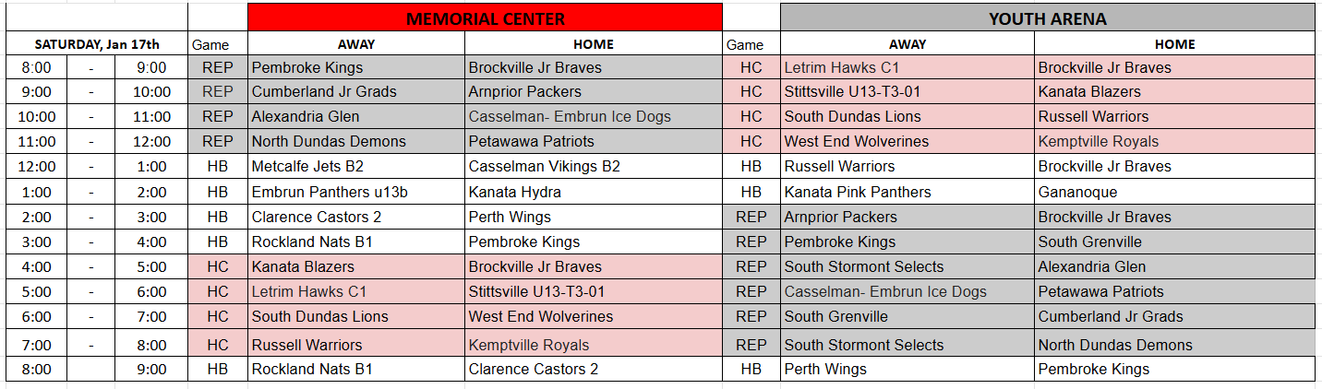
SCHEDULE – SATURDAY, JANUARY 17th

Slide 6
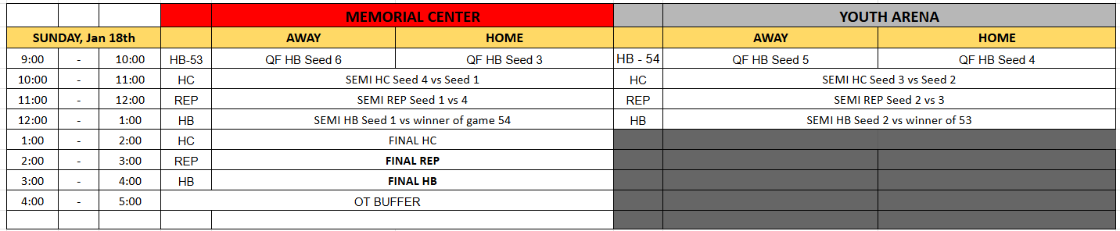
PLAY OFFS – SUNDAY, JANUARY 18th

Slide 7
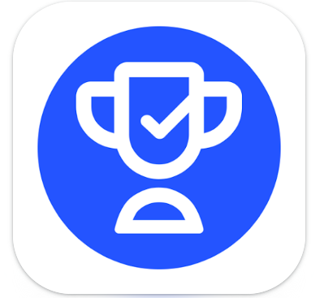
Access our webpage
www.gobmha.com
OR
Download the Teamlink App to access:
Schedules
Scores
Standings

Slide 8
BMHA Tournament Rules:
HEO Minor tournament rules apply, including the HEO Code of Discipline, as well as all rules listed below.
In accordance with the HEO rules, all players must wear (BNQ) HEO - approved neck protection. Goalies must wear approved neck protector, throat protector.
The Brockville Minor Hockey Association does not accept any responsibility of liability for accidents or injuries which may occur during the tournament or during travel to and from tournament games.
Changerooms are expected to be left in a clean and undamaged conditions. Appropriate teams will be held responsible for any damages to changerooms or other parts of the rink/facilities
This sanctioned minor hockey is open to U13 rep and house teams.
Each team will be allowed to register 18 skaters and 2 goaltenders. Roster changes will not be permitted to register players from another team in their association unless they are on their certified affiliated players list. All affiliated players must have proper documentation and be identified on the game sheet as an AP.
All sanctions and/or suspensions imposed on any player or team official prior to start of the tournament will remain in effect during the tournament. Anyone serving a suspension should be noted on the official game report when line-ups are filled out by the manager or coach.
Players can be used by only one team from any association in this tournament.
Example: Brockville house league team member cannot be called up as an affiliate by the Brockville rep team, even if the house team has been eliminated from the tournament.
A player must participate in at least one game in the round-robin part of the tournament to be eligible for quarters, semis, and/or finals.

Slide 9
The HOME and VISITING TEAM will be assigned by the tournament organizers for all round-robin games. The HOME TEAM will wear WHITE/LIGHT COLOURED jerseys. The team with the highest point total from pool games will be the Home Team in the semi-final and final games.
A team official must sign each game sheet when submitting the line-up.
  Note: You must indicate your team’s trainer's official card number on each game report.
Each team is guaranteed three games. All tournament games will be played at the Brockville Memorial Civic Centre & Brockville Centennial Youth Arena. No other rinks will be used for games except in the event of scheduling emergencies.
Minor Penalties = 2 min. Major penalties = 4 min.
Running clock: Minor penalties = 3 min, Major penalties = 5min
All games will consist of three 10-minute stop time periods, with a two-minute warm-up. Round-robin games will have a 50-minute curfew.
Handshakes will take place following each game.
Any fighting will equal ejection of player for the remainder of the tournament.
During the third period, running time will commence if there is a five (5) or more goal spread, and will not revert to stop time for any reason. While all scoring will be recorded on the official game sheet, the score clock will not reflect more than a 5-goal differential.
Hustler of the game awards will be presented after each game to each team. Hustler Award winners will be chosen by the bench staff of their own team and be presented by a Brockville volunteer or referee.
There are NO timeouts allowed during round-robin games. In the quarters, semis, and finals, each team is allowed one 30-second timeout. The head coach will ask the referee for his team’s timeout during a stoppage in play. NO TIMEOUTS IN OT PERIODS.
A two or three-referee system will be used for all games, with all refs and linesmen certified by HEO to work this level

Slide 10
ROUND-ROBIN
Round-robin games will be used to determine teams advancing to rounds as follows: Teams receive 2 points for a win, 1 point for a tie, and 0 points for a loss.
There are no overtime periods if the score is tied after any round robin game.
If a team forfeits a game (no show or drops out), that team is automatically allotted a default loss with a score of 0-3.
For House B – The top 2 teams in each pool will advance to the playoffs. Seeds 1 and 2 automatically advance to the semi-finals. Seeds 3 to 6 play a quarter-final game.
For REP & House C – The top 2 teams in each pool advance to the semi-finals.
If after round-robin play there is a tie in total points, the following will be used as
TIE-BREAKERS:
If 2 teams are tied in points; the team winning the head-to-head contest will be ranked higher.
Two or more teams tied; the team with the best goal differential (goals for minus goals against) will be ranked higher.
Teams still tied; the team with the fewest number of goals against will be ranked higher.
Teams still tied; the team with the greatest number of goals for will be ranked higher.
Teams still tied; the team scoring the earliest goal in their 1st game will be ranked higher.
A coin toss will decide rank.

Slide 11
QUARTERS, SEMI-FINALS and FINALS TIE BREAKER
In the quarters, semi-finals or finals, if a game is tied after regulation play (not curfewed), the winner will be determined as follows:
Quarters/Semi-finals/finals: Teams will play an overtime period, with 4 players aside (three-on-three plus goalie).
THIS IS SUDDEN VICTORY HOCKEY - FIRST GOAL WINS! Note: teams will switch ends for the beginning of the overtime period. If a penalty is called during the three-on-three overtime, the non-offending team will put an additional skater on the ice to gain the man advantage for the duration of the penalty to the next play stoppage.
Quarters, Semi-finals: Teams will play one, 5-minute OT period. If no winner is determined after the OT, a shootout will take place.
Finals: Teams will play one, 10-minute OT period. If no winner is determined after the OT, a shootout will take place.
Shootout: Best of five shoot out. Individual shooters will shoot simultaneously. If still tied after 5 shooters each, sudden victory shooters will occur until 1 team is victorious. Officials will keep track to ensure no player shoots twice until the whole team has shot (goaltenders and players serving penalties excluded).
NOTE: No 30-second timeouts can be requested by the coach at any time during an overtime period. Timeouts are strictly for the first three periods of each game.

Slide 12
PROTEST PROCEDURES
Tournament co-ordinator and tournament officials will resolve any disputes concerning the application or interpretation of the tournament rules. All decisions taken by the co-ordinator and officials of the BMHA tournament are binding and not subject to appeal. A $100 deposit is required for any protest. This deposit is non-refundable if the protest is not upheld.
Judgement calls by officials are not subject to protest.
For further information, please contact:
Ashley Kert-Brown (U13 Convenor) ashleykaertbrown@gmail.com
Brad Boucock (On Site Tournament Director) bmha.tournament1@gmail.com
We are looking forward to a great weekend of hockey in Brockville, and we welcome all of our visiting teams, including those who are returning, and continue to support our tournament year after year! Our focus is to ensure that every player enjoys their time at our tournament. Remember that is just a game! KEEP IT FUN FOR THE KIDS!
Best of Luck to Everyone!

Slide 13
Support our local restaurants
Luna Pizzeria
http://www.lunapizza.com/
Nakhon Thai Restaurant
http://www.nakhonthai.ca
The Mill
http://www.themillrestaurant.ca
Don’s Fish & Chips
http://www.donsfishandchips.com
The Keystorm
http://www.keystormpub.ca

Slide 14
GOOD LUCK EVERYONE!

